Slide 1


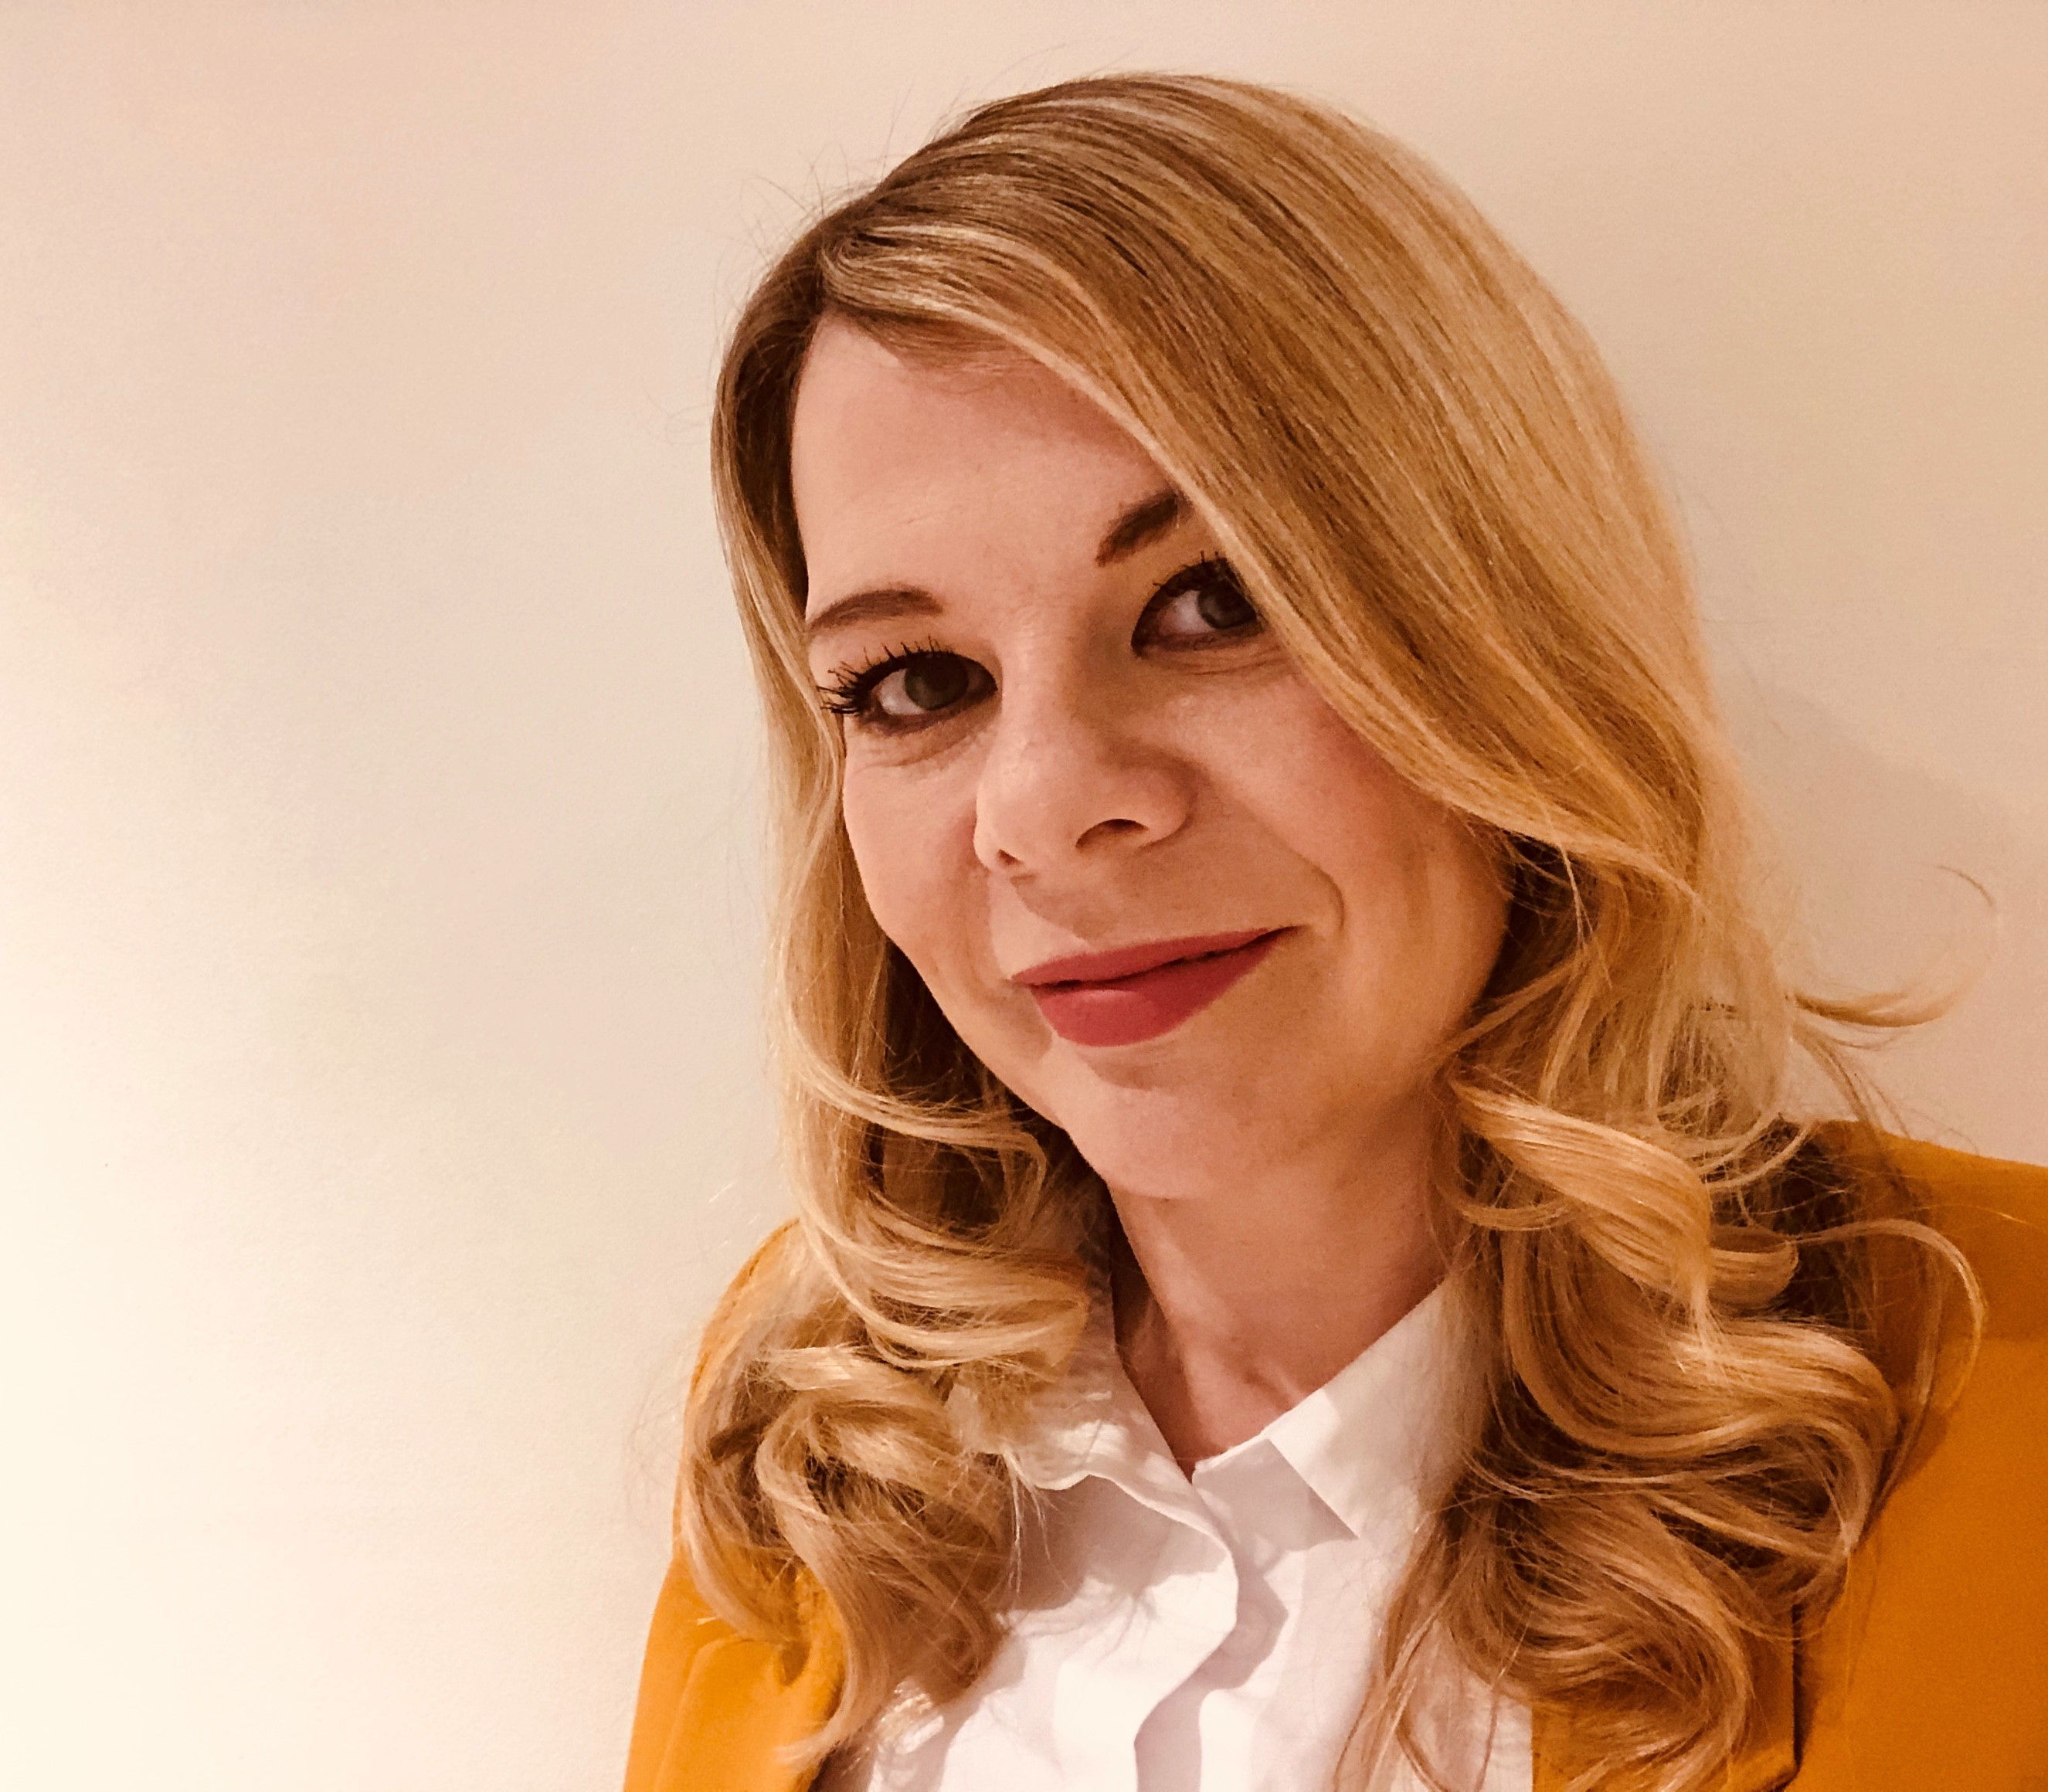
Meet the BP Team
Issue worked on
Who are we? What do we do?
Outputs and value
We build relationships with programme delivery teams, gaining their trust, providing best practice portfolio management knowledge and support on an ongoing basis. Just some examples of this from the last sprint:
Worked with multiple programmes that are closing to guide and direct them through the process. Including reviewing closure reports to ensure a full hand over and tie up of all elements before submission to the Delivery Assurance Board.
Worked with all programmes to support re-planning of the programmes and changes to baselined milestones. Helping the starting position to provide a clear view of the current outcomes and deliverables that the portfolio aim to achieve in 2020/2021. forecast vs baselined
Provide insight and intelligence to portfolio performance, reviewing the reporting outputs:
(1) The data is correct (working with delivery teams and the reporting team)
(2) Any messaging and analysis is correct and gives the right message
(3) Provide insight and recommendations for EEMT
Blockers
Our challenges are those faced by most PMOs, we actively work on how we overcome these with an understanding that many of these come with the ask of the role
Delivery teams simply just want to deliver and sometimes can be wary of governance and reporting. We work continuously to break down barriers and gain trust.
Demonstrating direct quantifiable value - the business partner team can in some ways be accountable for nothing and everything at the same time. We don’t own outputs but if there are any communication or quality issues, we need to make sure we are proactive in identifying and resolving these early on.
Modele Laucius
Olivia Bartley
Karl Blackshaw
Julie Griffiths-Burdon
Notes:
Set the scene of why this is a different to normal show and tell
Include some examples of the other things we deliver i.e. IPA / quality guidance / roll out of new tools / projects
Include ratios i.e. 80% BAU then small amount of project work
Talk about the constructive challenge both within CPMO and with delivery teams

Slide 2
CPO Business Partner Role Overview
Business Partner Team Overview
The role of the Business Partner Team is to support and influence quality, reporting and governance across NHS Digital directorates (programmes and services) by building insightful relationships with relevant decision makers throughout the organisation by:
Improving consistency in standards, frameworks and policy across the portfolio and provide guidance and support to the programmes and services
Working with the CPO to provide expertise in leading and embedding robust standards and processes
How will Business Partners Support the Directorates?
Primary liaison point for the programmes in applying standards, frameworks and techniques to successfully deliver the outcomes of the programmes
Assist directorates tackle cross-system and NHSD Portfolio and Programme Management activities
Bring an impartial perspective and ‘critical friend’ view through, enabling internal and external assurance
Give “first line” support on PM standards and connect people to information and experts
Gain a better understanding of Programme delivery and challenges to enable better central reporting and analysis (and deal with more centrally to lighten the burden on the teams)
Bring and share good practice and lessons learnt from other functional areas by working closely with the CPO and other Business Partners
Deliver a coherent process for quality improvement on the programmes that is fully understood, well communicated and adhered to, and which is continually reviewed for improvement.

Slide 3
Programme split by business partner
Programme Name | Business Partner
Citizen Identity | Karl Blackshaw
The NHS App | Karl Blackshaw
Integrating Care | Karl Blackshaw
Provider Digitisation | Karl Blackshaw
Data Processing Services | Karl Blackshaw
Data Content & New Data Connections | Karl Blackshaw
HSCN | Karl Blackshaw
Data & Cyber Security | Karl Blackshaw
Digital Transformation of Screening | Karl Blackshaw
Digital Referrals & Consultations | Olivia Kane
GP Connect | Olivia Kane
GP IT Futures | Olivia Kane
GP Data for Planning & Research | Olivia Kane
Social Care | Olivia Kane
Medicine Data | Olivia Kane
Integrating Pharmacy Across Care Settings | Olivia Kane
Digital Child Health | Olivia Kane
Digital Maternity | Olivia Kane

Slide 4
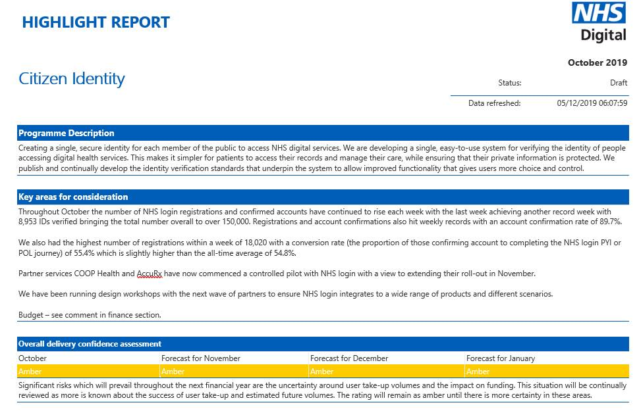
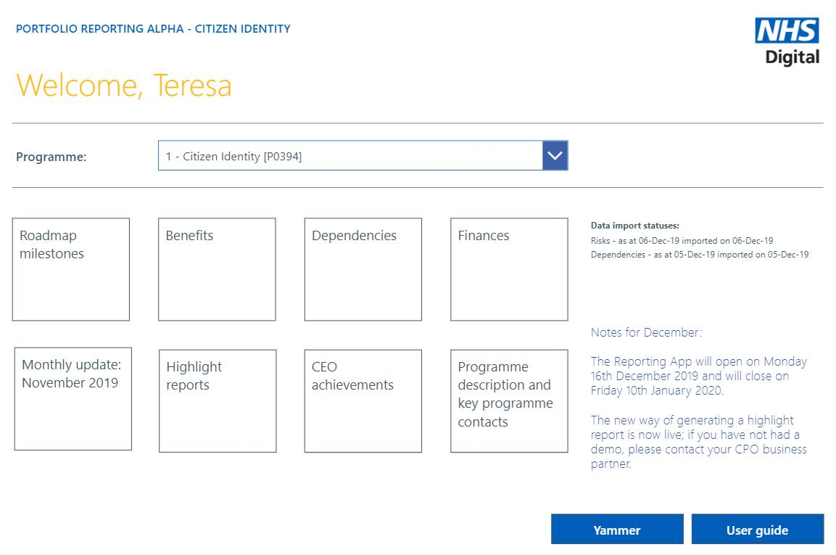
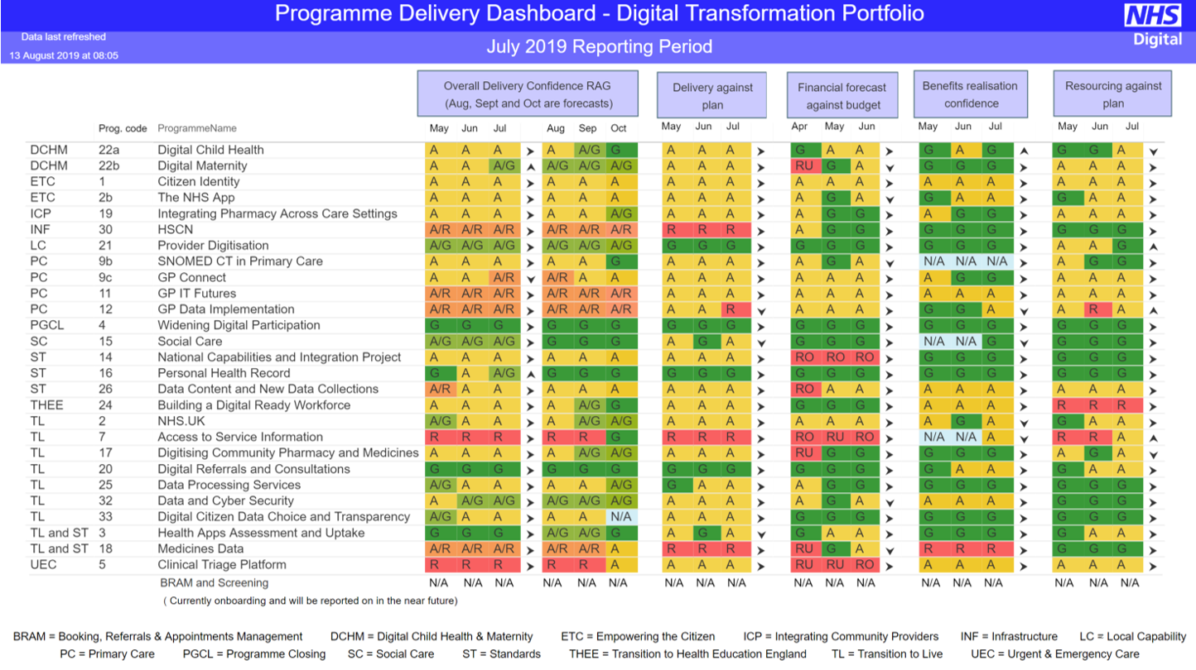
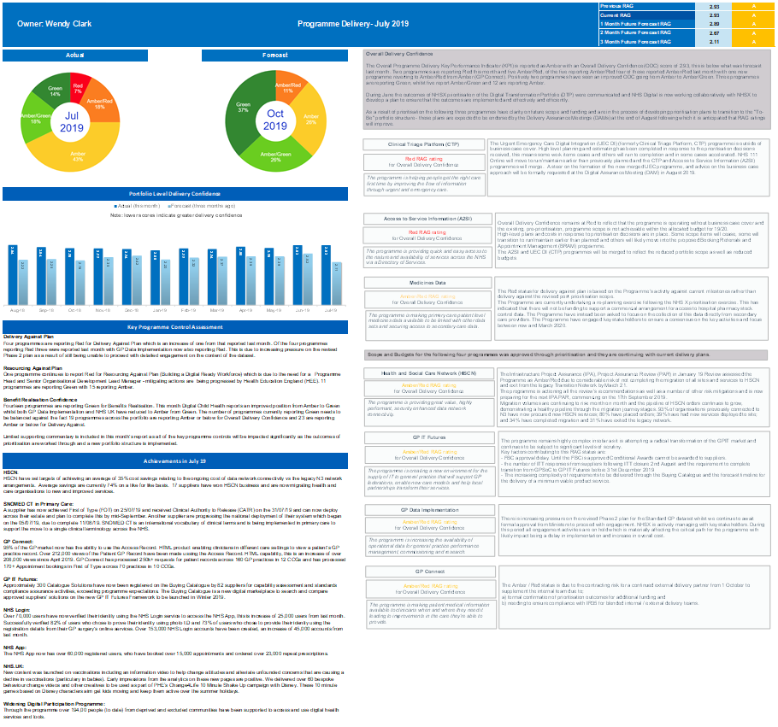
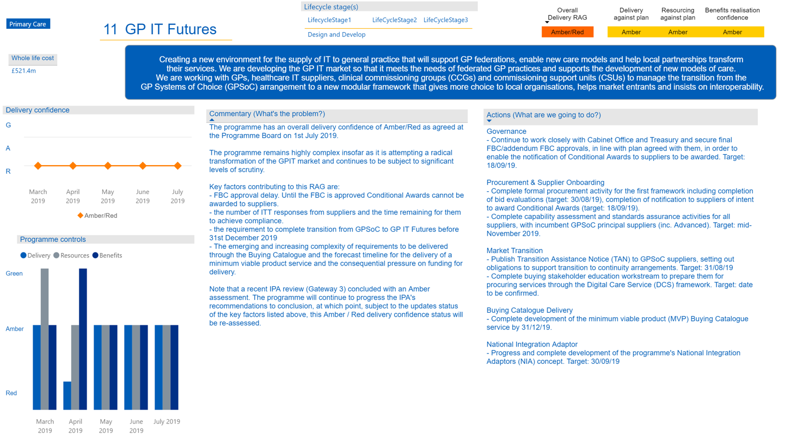
CPO Portfolio Reporting Inputs and Outputs
Highlight Report
Highlight Report
Highlight Report
Highlight Report
Highlight Report
Reporting App
EMT Performance Report
EMT Performance Report
EMT Performance Report
EMT Performance Report
EMT Performance Report
Portfolio Performance Report
Portfolio Performance Report
Portfolio Performance Report
Portfolio Performance Report
Portfolio Performance Report
Dependencies - Tracker
Milestone Tracker
Dependencies Tracker
Finance (Tagetik)
Milestone Tracker
Risk and Issues (CRIS)
Notes:
Roadmap Milestones
CPO pull though L1 (outcome and deliverables) milestones and baselines, from the milestone tracker, each month prior to the app being opened. Programme Teams enter their updated commentary once the App is open for input and can see last months commentary.
Benefits
Programme team update directly in the system, can see last months data in the system
Dependencies
Programme teams update the dependency tracker, CPO pull through data from the dependency tracker
Finances
Entered directly into the system by the finance business partners
Risks and Issues
Extracted from CRIS by the CPO and entered into the reporting APP. Prog team need to flag top 3 in CRIS, that auto pulls into highlight report

Slide 5
High Level Reporting Process
Highlight Report (HLR) Completed
SRO signs off (HLR)
CPO extract and analyse data
Portfolio Performance Report
NHS Digital
Delivery Assurance Board (DpAB)
Working Day 6-9
Working Day 10
NHSX
Digital Assurance Forum (DAF)
Working Day 5
NHSX new governance proposed to replace these current boards
NHSX
Digital Assurance Meeting (DAM)
NHSX
Digital Delivery Board (DDB)
Executive Management Team Pack
Product Director review
EMT Review
NHS Digital - Board
Working Day 10
Process
Document
Governance / Meeting

